Slide 1

Loan Defaulter Case Study
By : Mohammad Kafee Uddin &
Shraddha

Slide 2
Problem Statement
The company wants to reduce credit loss by identifying risky loan applicants. This involves understanding the driving factors behind loan default.
To address the business objectives outlined, we will conduct an exploratory data analysis (EDA) to understand the driving factors behind loan default. This will involve identifying strong indicators of default by analyzing various variables related to borrowers and loans.
We are going to follow following five steps of EDA in two sections:
1. Data sourcing
2. Data cleaning
3. Univariate analysis
4. Bivariate analysis
5. Derived metrics

Slide 3
Section 1 - Data Sourcing and Cleaning:
Obtain data related to borrowers, loans, and default status. preprocess the data to handle missing values, outliers, and any inconsistencies.
Missing value treatment
Handling incorrect data types

Slide 4
Section 2: Univariate, Bivariate, and Derived metrics analysis

Slide 5
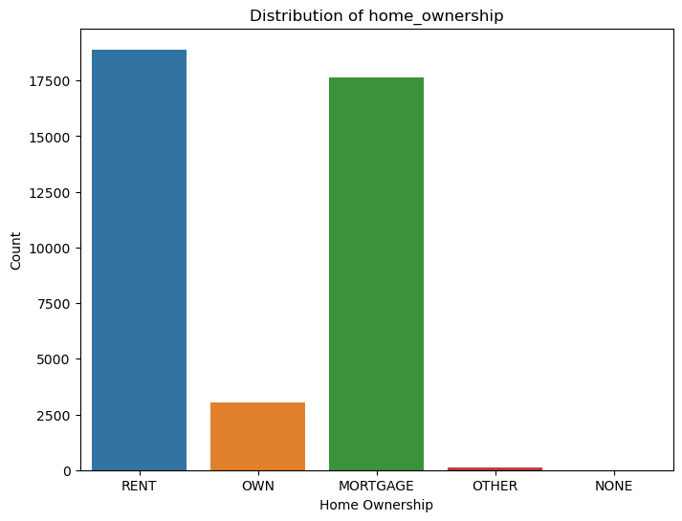
1a.)Univariate Analysis: From the distribution of home ownership plot, we can understand "rent" and mortgage" categories are mostly provided the loan.

Slide 6
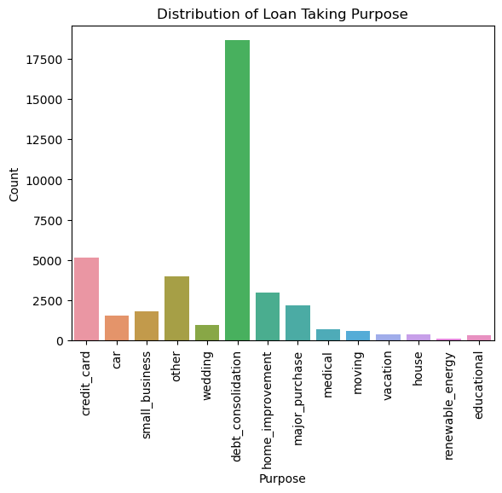
1b.)Univariate analysis: from the distribution of loan purpose plot, we can understand debt consolidation high purpose for loan applying.

Slide 7
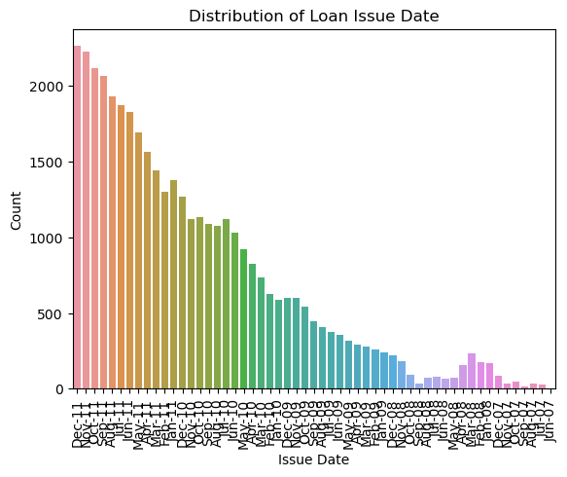
1c.)Univariate analysis: From the distribution of loan issue date plot, we can understand there is increase in applicant receiving by the months.

Slide 8
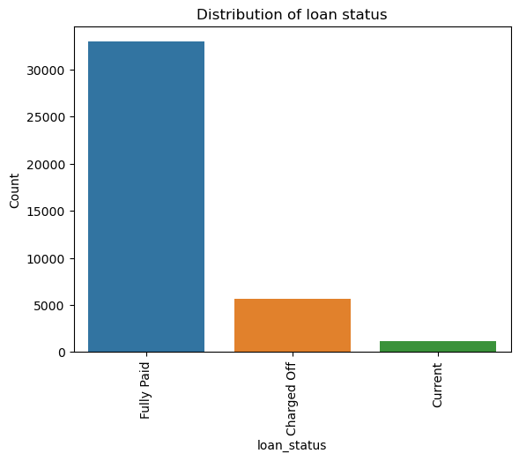
1d.)Univariate analysis: From the distribution of loan status plot, we can understand there are high number of applicate have already paid their loan

Slide 9
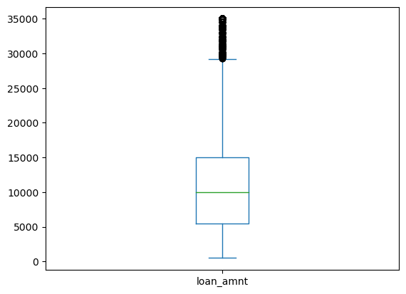
1e.)Univariate analysis: from the spread of loan amount, we can see median is around 10000

Slide 10
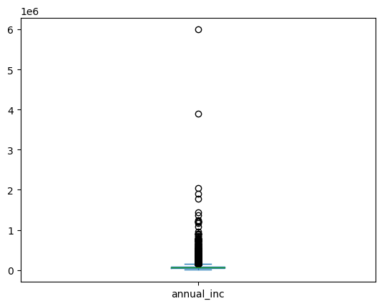
1f.)Univariate analysis: from the spread of annual income, we can see there are two outliers

Slide 11
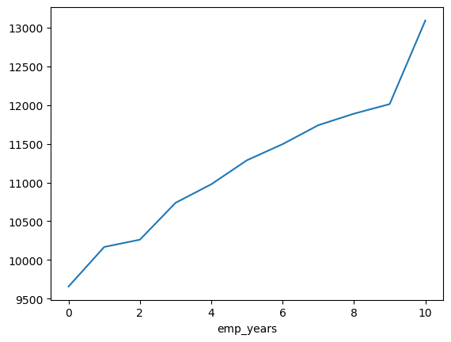
2.Segmented univariates: From the applicant years of employment, it is clearly visible avg income has increased.

Slide 12
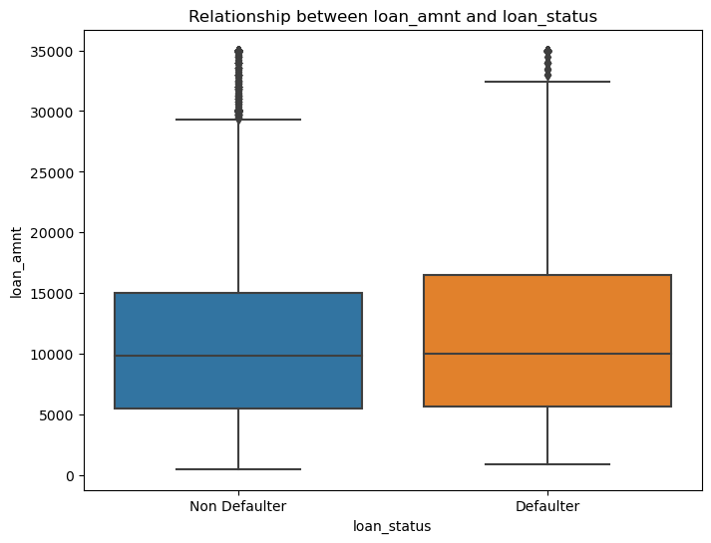
3a.)Bivariate analysis: High loan amount are more defaulter

Slide 13
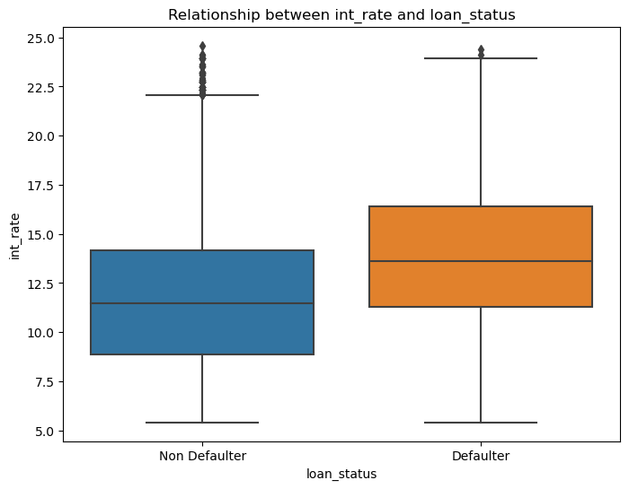
3b.)Bivariate analysis: High interest rate are more defaulter

Slide 14
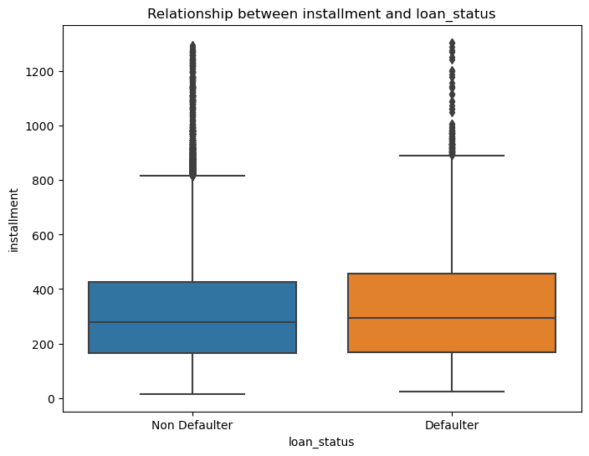
3c.)Bivariate analysis: High installment are more defaulter

Slide 15
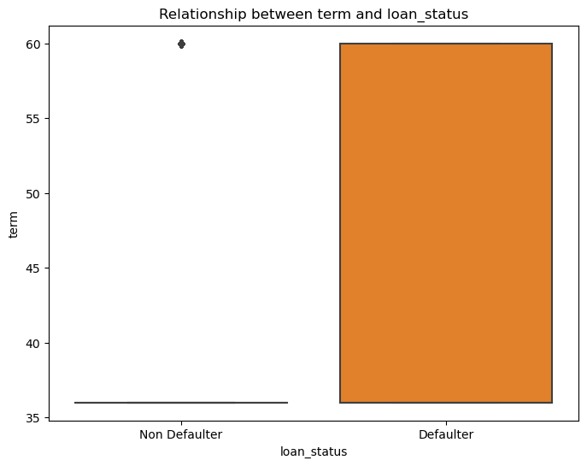
3d.)Bivariate analysis: Higher term are more defaulter

Slide 16
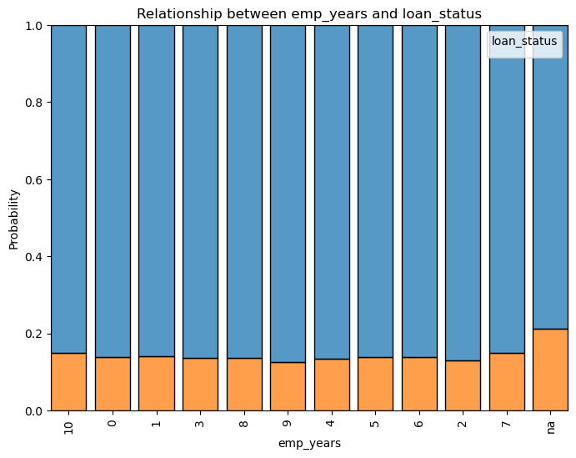
3e.)Bivariate analysis: 9 years employment are less defaulter.

Slide 17
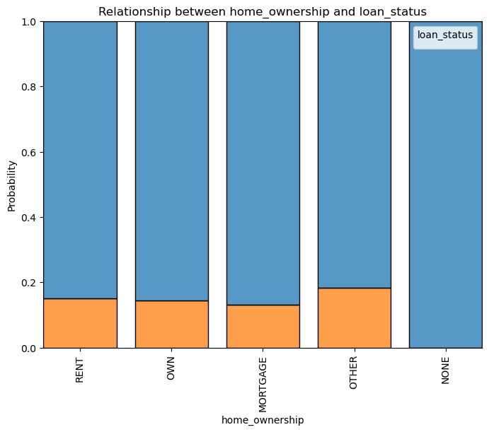
3f.)Bivariate analysis: Mortgage ownership are less defaulter.

Slide 18
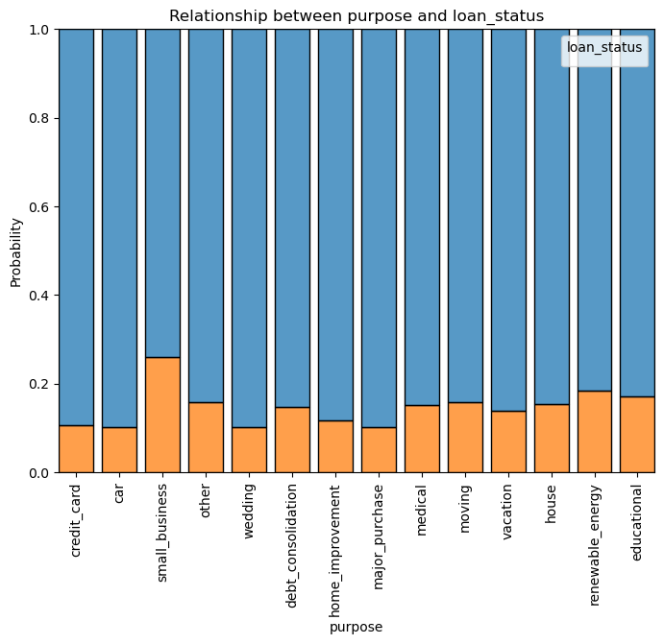
3g.)Bivariate analysis: Small business are more defaulter

Slide 19
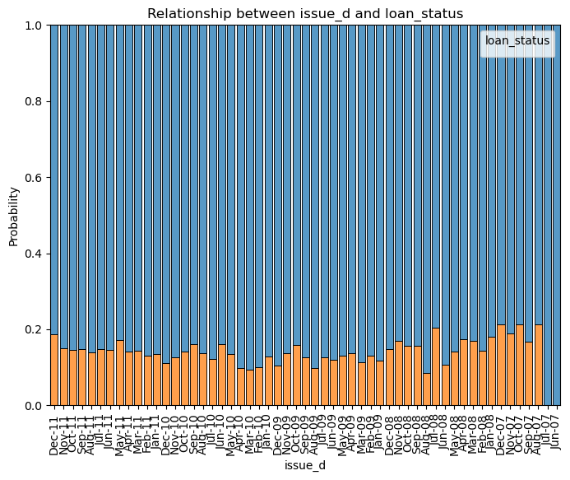
3h.)Bivariate analysis: Defaulter trend has changed from higher to lower to higher again with passing months.

Slide 20
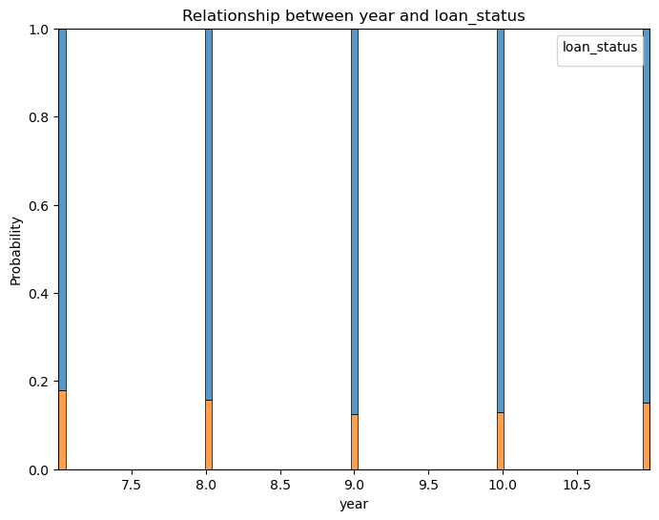
4.Derived metrics analysis: In the year 2007 probability of defaulter is higher as compared to other years.

Slide 21
With the analysis above it can be concluded that, purpose of loan, ownership of applicant, term of loan, income of the applicant and employment years are the strong factors whether it will be defaulted or not.

Slide 22
Thank You

